Slide 1
ENGR3420 Analog and Digital Communications Project Presentation:
Signal Solver
Tolulope Oshinowo

Slide 2
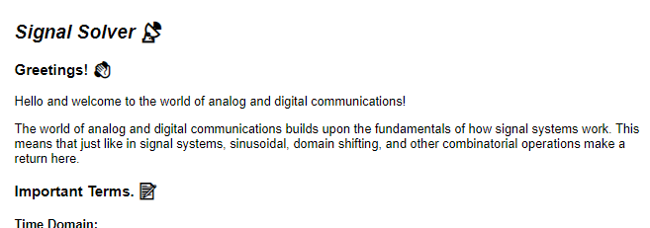
Background
Wanted to create an educational and interactive experience to showcase my understanding.
Believed that creating a game would be a great way of accomplishing this objective.
Figured that designing a game for 14-18 year olds would be an interesting challenge.
Looked to nostalgia for inspiration.
Screencap of the tutorial section of the game.
A gif of the game that served as inspiration.

Slide 3
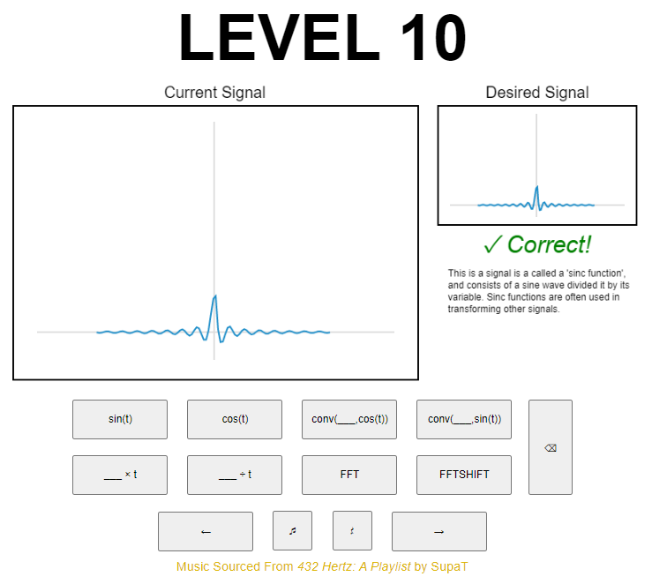
Project Scope
Undertook an unorthodox approach by making a game.
Opted to also include a short tutorial to help the user get up to speed.
The game’s UI:
Current signal, and desired output signal windows.
Multiple buttons to apply operations.
Prioritized depth over breadth for UX.
Screencap of the final game’s UI.

Slide 4
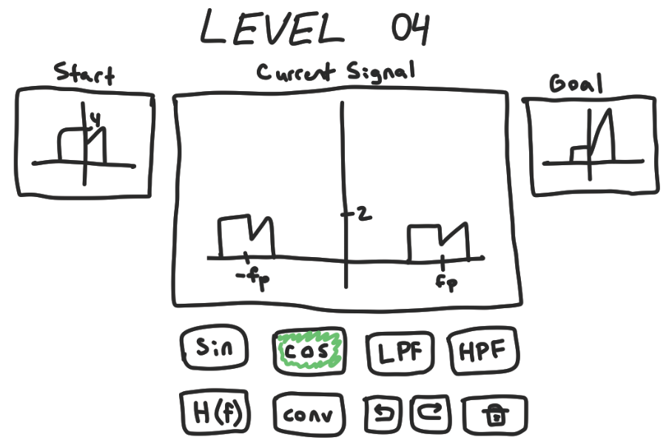
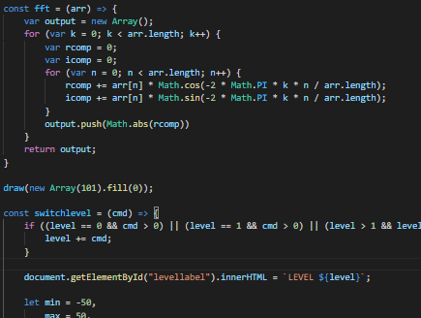
Methodology
Sketched out possible layouts.
Made a list of desired features for the game.
Mapped out architecture for code.
Decided to write in JS to maximize accessibility.
Reverse-engineered parts of MATLAB’s Signal Processing Toolbox and Python’s NumPy.
Utilized beta testing.
Original game mockup sketch.
Code snippet of the fft function.

Slide 5
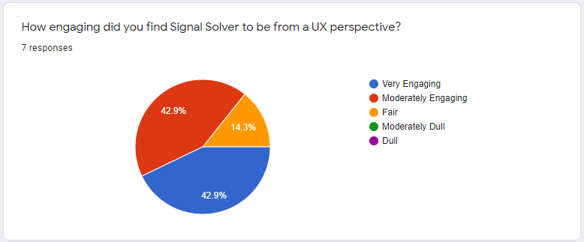
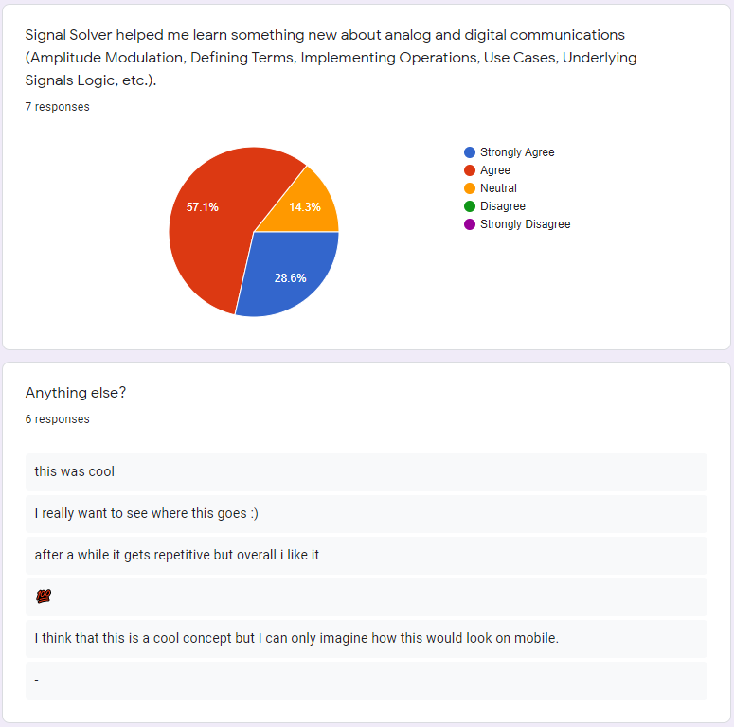
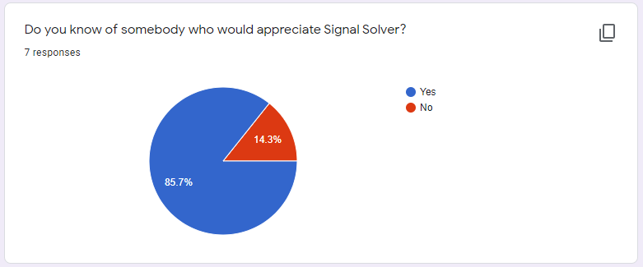
Results
Collected info from beta testers.
Gathered feedback from a sent out survey.
Received generally positive reviews.
Realized that there is still plenty of room for improvement.
Results from the survey.

Slide 6
Future Work
Host game on the OSSTP website.🎉
Figure out how to make the game more ubiquitous.
Bring back functions I couldn’t get to work (LPF).
Create a story to go along with the game.
Port the game to other languages.
Contribute to getting today’s youth more interested in AD comms.
A gif of the game in action.

Slide 7
Questions?
Wanna play? https://sites.google.com/view/signalsolver/home
Repo?
https://github.com/toluooshy/Signal-Solver
Shameless plug:
https://open.spotify.com/album/0EkxPQCZmN6Ujy9MVa8VhA?si=6Tf1WUM3RBCIZrAVIAtk9A

Slide 8
References
Govindasamy, Siddhartan, et al. Analog and Digital Communications. 1st ed., Olin College of Engineering, 2021.
MATLAB and Signal Processing Toolbox Release 2021a, The MathWorks, Inc., Natick, Massachusetts, United States.
Harris, C.R., Millman, K.J., van der Walt, S.J. et al. Array programming with NumPy. Nature 585, 357–362 (2020). DOI: 10.1038/s41586-020-2649-2. (Publisher link).
“DSP-Kit.” Home - Postman Documentation, https://oramics.github.io/dsp-kit/api/index.html.
games, Coolmath. “Play Factory Balls - Copy Wacky Designs: Coolmath Games.” Play Factory Balls - Copy Wacky Designs | Coolmath Games, https://www.coolmathgames.com/0-factory-balls.
432 Hertz: A Playlist, SupaT Records, 30 May 2021, https://open.spotify.com/album/0EkxPQCZmN6Ujy9MVa8VhA?si=6Tf1WUM3RBCIZrAVIAtk9A. Accessed 7 Dec. 2021. \

